Slide 1
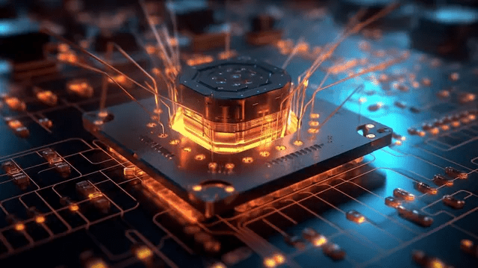
Quantum Computing
Presenter: Kinzang Tenzin Tshokey
Class: 9A

Slide 2
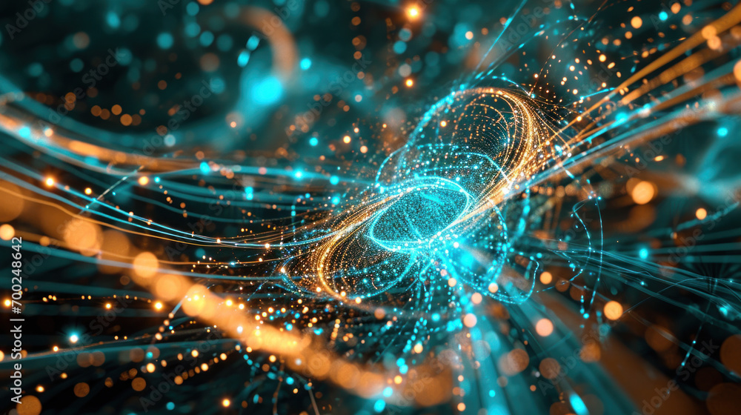
What is Quantum Computing?
few type of computing based on quantum mechanics
Uses quantum bits (qubits) instead of classical bits
Unlike classical bits (0 or 1), qubits can be 0A n, 1, or both at the same time

Slide 3

Technology Operation (Core Idea)
1. Qubits
Basic unit of quantum information
Can exist in multiple states at once
2. Superposition
A qubit can represent 0 and 1 simultaneously
Increases computing power massively
3. Entanglement
Qubits become linked
Changing one instantly affects the other
4. Quantum Gates
Perform operations on qubits (like logic gates in classical computers)

Slide 4
How Quantum Computing Works (Simple Flow)
1. Problem is encoded into qubits
2. Qubits enter superposition
3.Quantum operations are applied
4.Entanglement links qubits for complex processing
5.Measurement collapses result into a final answer

Slide 5
Why It’s Powerful ?
Can process many possibilities at once
Solves certain problems much faster than classical computers
Especially strong in:
Simulation
Optimizati
cryptography

Slide 6
Industry Impact
1. Healthcare
Faster drug discovery
Protein folding simulations
2. Finance
Better risk analysis
Portfolio optimization
3. Cybersecurity
Breaks current encryption systems
Leads to new “quantum-safe” encryption
4. Logistics & Transport
Optimized delivery routes
Supply chain improvements

Slide 7
Future Possibilities
1. Ultra-fast problem solving for global challenges
2.Advanced AI training and modeling
3.Climate prediction with higher accuracy
4.Fully quantum internet (secure communication networks)
5.Medical breakthroughs (customized medicine)

Slide 8
conclusion
Quantum computing is a revolutionary technology
It is not replacing classical computers yet
It will solve problems currently impossible to compute
Ethical use and regulation will be critical

Slide 9

fd

